Slide 1

9. Radiation & Antennas
7e Applied EM by Ulaby and Ravaioli

Slide 2
Overview
Introduction of Antenna Project
Radiation Mechanism (9-1)
Various types of antennas (9-1)
Hertzian Dipole (9-1)
Basic Antenna Radiation Characteristics (9-2)
Image Theory of Antenna
Half-wave Dipole and Monopole (9-3)
Friis Transmission Formula
Two-Element Array (9-9 and 9-10)
Summary

Slide 3
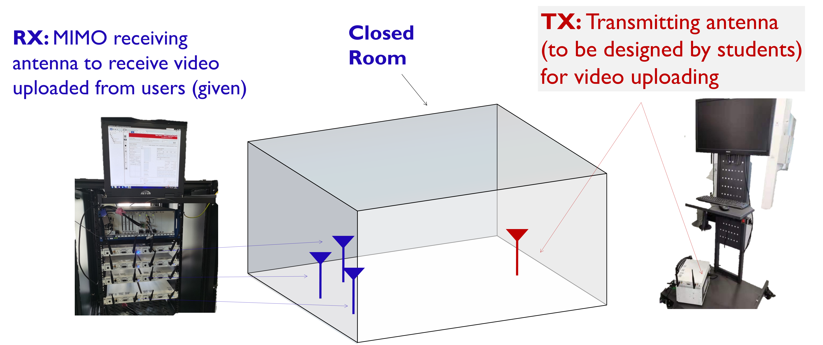
Antenna Project
Task: to design a device that allows signal to be transmitted from the transmitter to the receiver
Objective: communication rate > 10 Mbits/s

Slide 4
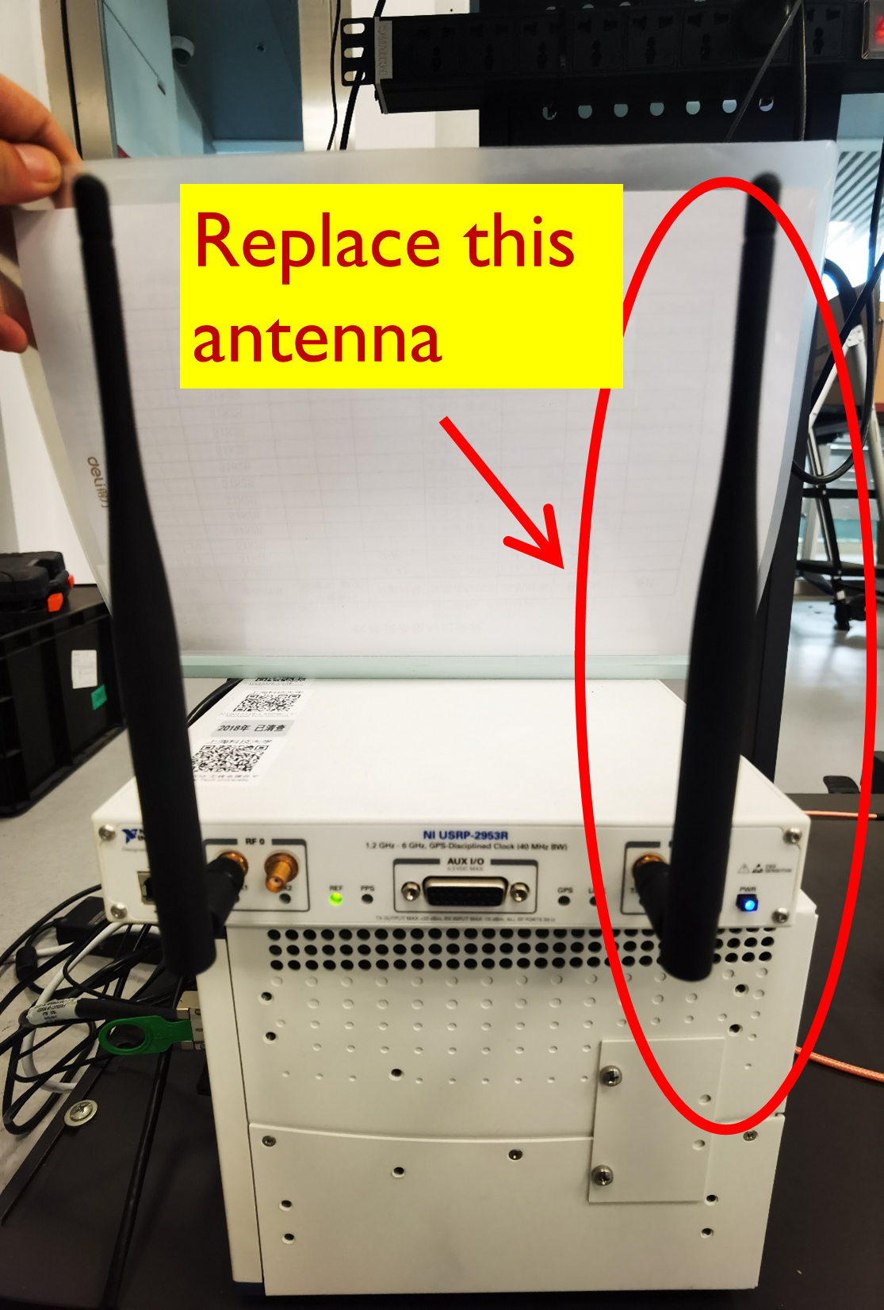
Antenna Specifications
A well-set two-antenna TX antenna system is shown in the figure. Students are to design their own antenna to replace the highlighted one.
Recommended antenna specifications: (also typical technical specifications for 2G base stations)
Center frequency: 3.6 GHz
Bandwidth: > 40 MHz
In-band |VSWR|: < 2
In-band Antenna Efficiency > 50 %
Radiation pattern: directional or omni-directional
Antenna type: monopole, dipole, spiral etc.
We are going to learn them now.

Slide 5
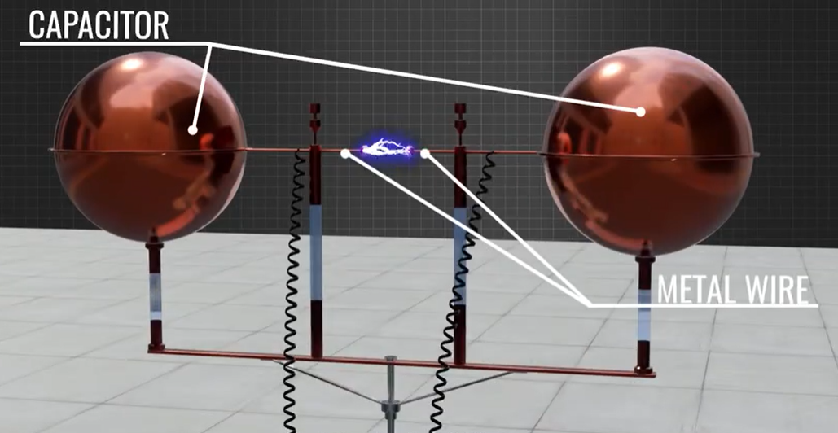
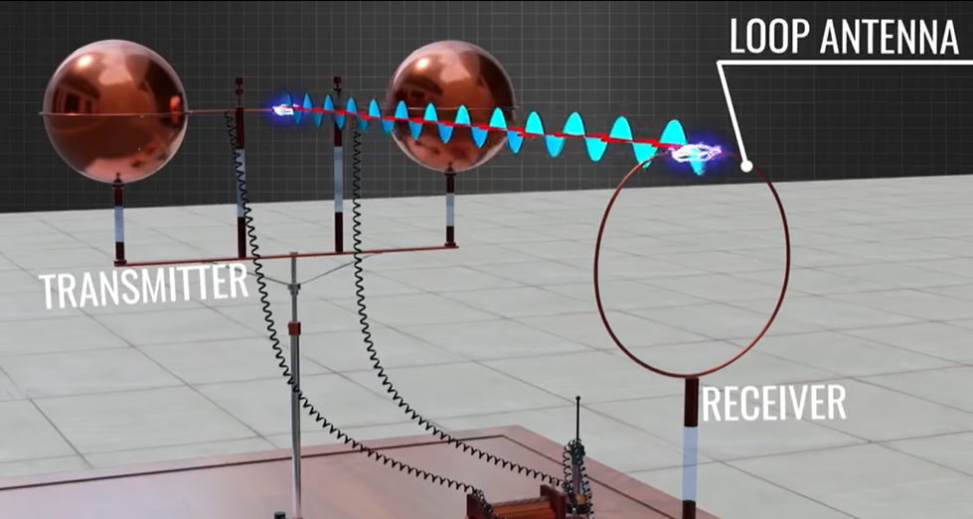
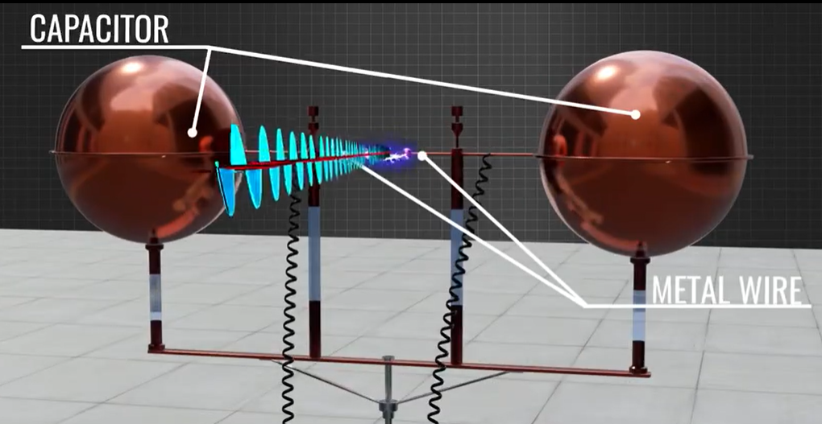
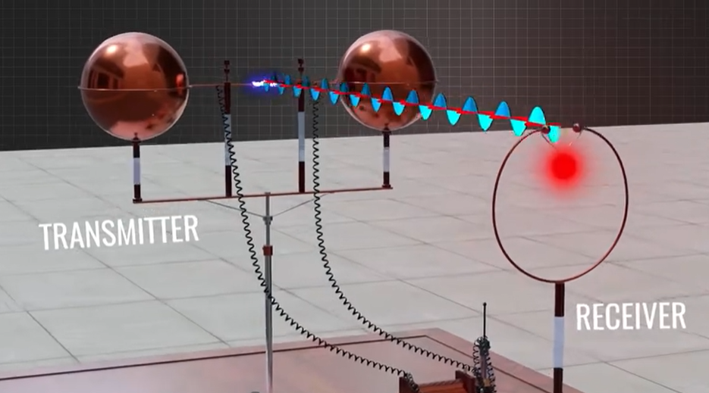
Hertz’s Experiment: origin of antenna
High voltage on two wires → sparks in gap
EM travels through the air in certain direction
Another spark is created at the receiver and light up an LED
Sparks lead to EM waves leaving the wires

Slide 6
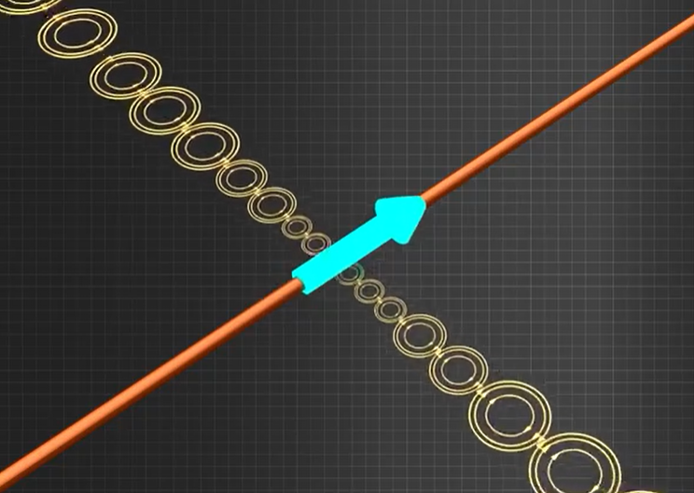
Radiation Mechanism
Question: How do EM fields leave from wires and propagate through a space? (radiation principle)
Radiating EM field
Source of radiation:
accelerated charged particles.
(more details in the next page)
Radiating EM field

Slide 7
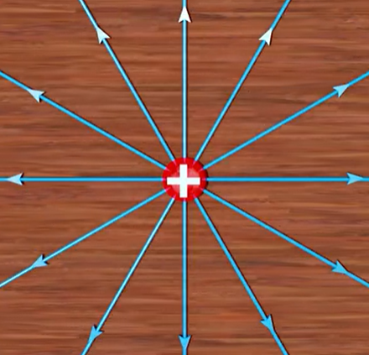
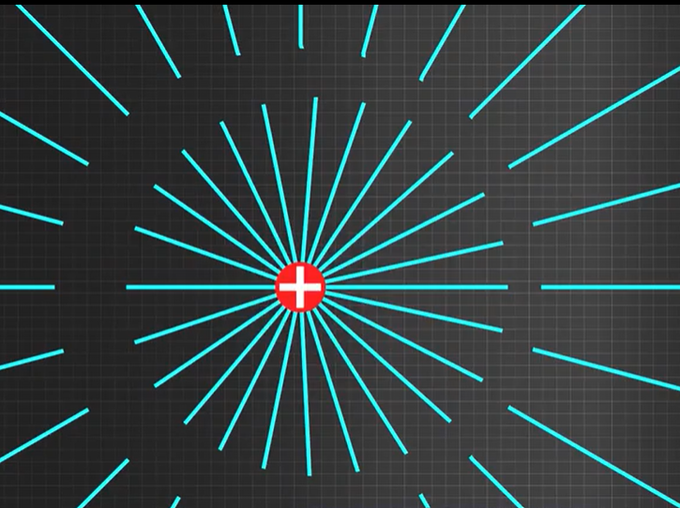
Radiation Mechanism
Old field
acceleration
E-field of static charge in a constant velocity (both speed and direction)
New field
Accelerated charge creates a kink (discontinuity) between old field and new field
Radiating EM field

Slide 8
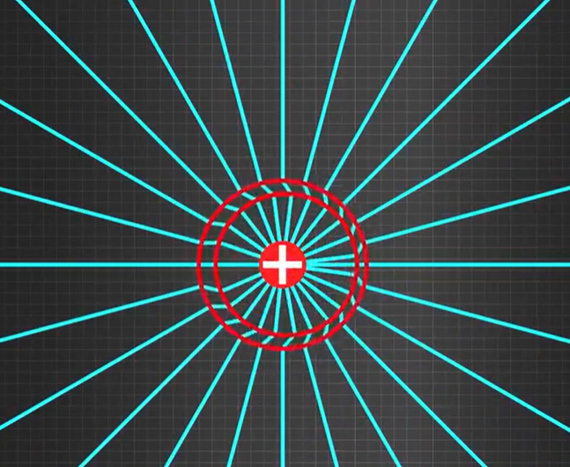
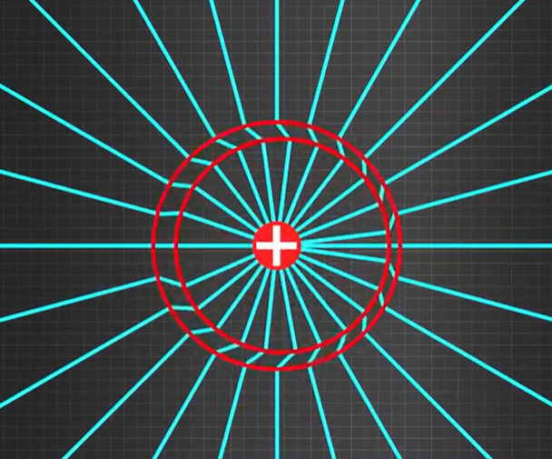
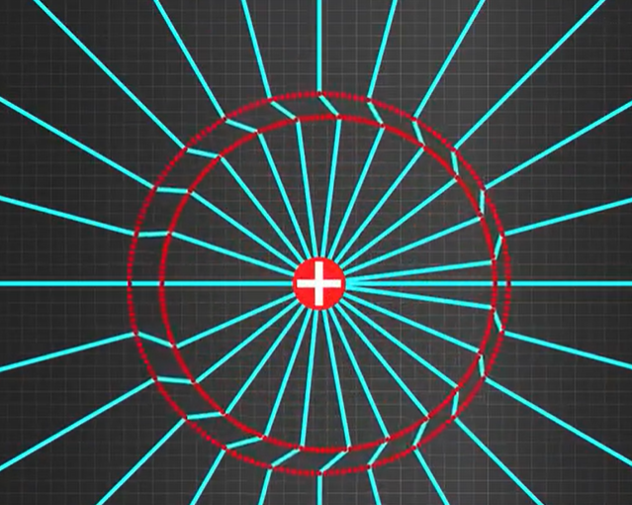
Radiation Mechanism
Let a camera move at same speed with the charge (speed of light!). The kink propagates out.
Conclusion: acceleration of the charge has caused electromagnetic radiation

Slide 9

Radiation Mechanism
Concept of Dipole : two oscillating charges

Slide 10
Fields of Moving Charges
A good resource
http://phet.colorado.edu/sims/radiating-charge/radiating-charge_en.html
A static charge produces static electric field at the speed of light
When a charge is moving, the generated electric fields change accordingly
When the charge moves with acceleration, the generated electric fields exhibit oscillating natures, which will in turn generate magnetic fields and form electromagnetic fields

Slide 11
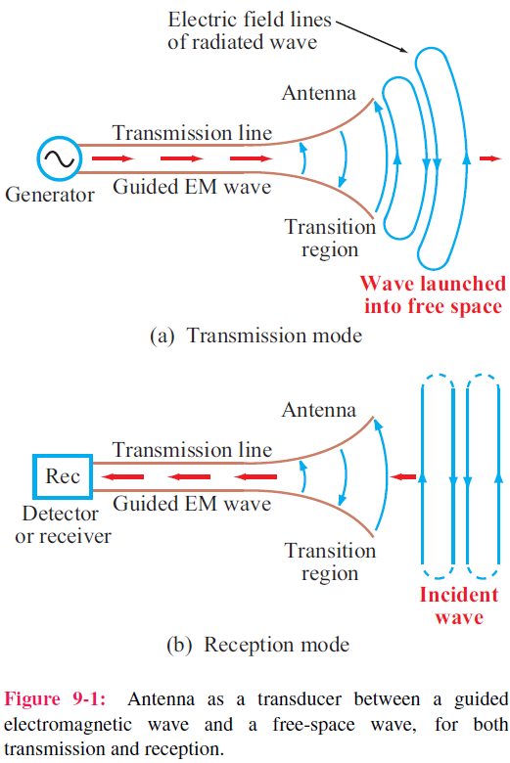
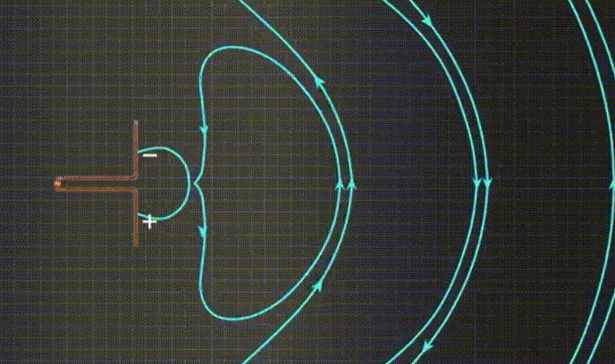
TX: Wave from T-Line to Space
Antenna in transmitting mode
An antenna serves to radiate electromagnetic field

Slide 12
Analogy to Capacitor
Use the analogy between a capacitor and an antenna to give an intuitive explanation of radiation
This analogy is based on the fact that the electric fields generates displacement currents that together with the conduction currents form a closed loop of the circuit
Capacitor
Antenna
V
E

Slide 13
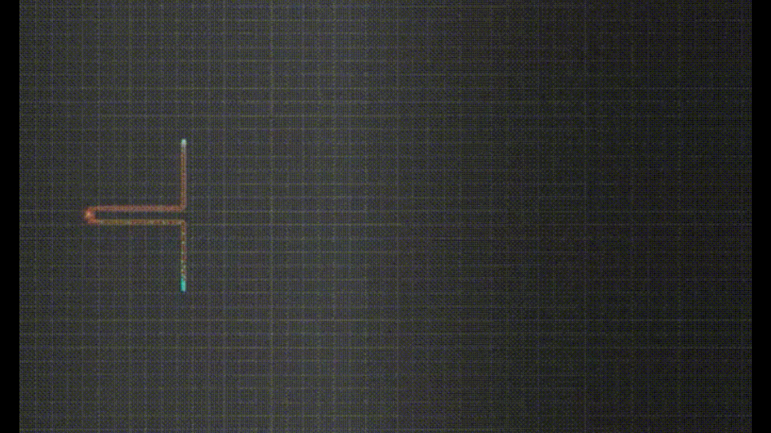
RX: Wave from Space to T-Line
Antenna in RX mode
The same antenna serves to receive electromagnetic field
Oscillating fields of waves induce positive and negative charges at the ends of the antenna. A varying voltage signal is produced at the center gap of the antenna, which propagates along the T-Line to the detector or receiver.

Slide 14

Antenna Properties
1. An antenna is a transducer that converts efficiently a guided wave propagating on a transmission line into an electromagnetic wave propagating in an unbounded medium (usually free space), or vice versa.
2. Most antennas are reciprocal devices, exhibiting the same radiation pattern for transmission as for reception.
3. Being a reciprocal device, an antenna, when operating in the receiving mode, can extract from an incident wave only
that component of the wave whose electric field matches the antenna polarization state.

Slide 15
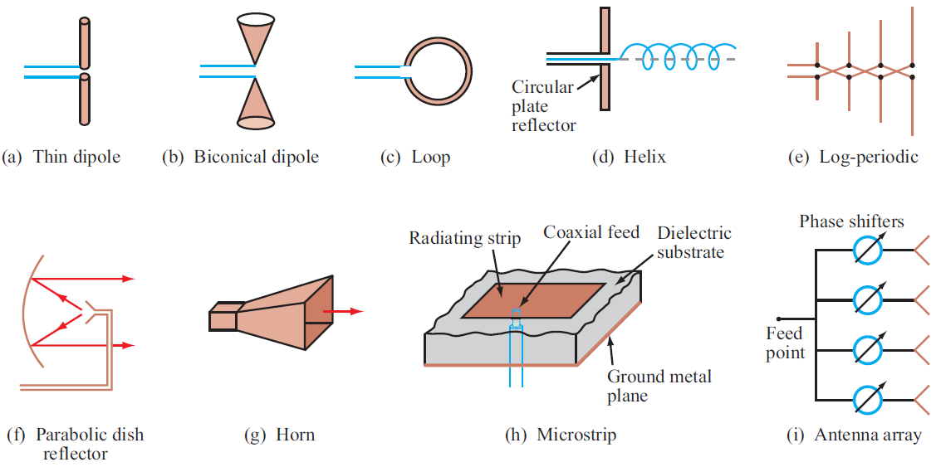
Examples of Antennas

Slide 16
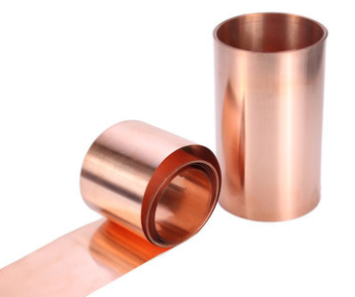


Example of Monopole Antenna
Conducting wire
L
Conducting Plate
W
Project:
You can tune the length L and ground width W for maximum antenna efficiency in 3.6-GHz band, by hands or by simulation first.
SMA connector, antenna input port

Slide 17
General Circuit-Model of Antennas
Due to reciprocity, TX mode is assumed from now on, unless otherwise specified.
A
Z₀，βl
Antenna Impedance Z_{A}
Input impedance of the antenna when looking toward the load, at A-A’，complex in general
Z_{g}
Z_{A}
Z_{A} = R_{rad} + R_{loss} + jX_{A}
A’
Z₀，βl
R_{rad} : radiation resistance, scalar, a measurement of how much power is radiated to the whole space. (related to antenna design，e.g., antenna length)
R_{loss} : loss resistance, scalar, a measurement of how much power is converted to heat due to finite conductivity of conducting materials (σ) and dielectric loss (μ’’and ε’’). (related to material and antenna design)
X_{A} : antenna reactance, scalar, a measurement of how much power is restored inside the antenna. (related to material and antenna design）
Z_{A}

Slide 18
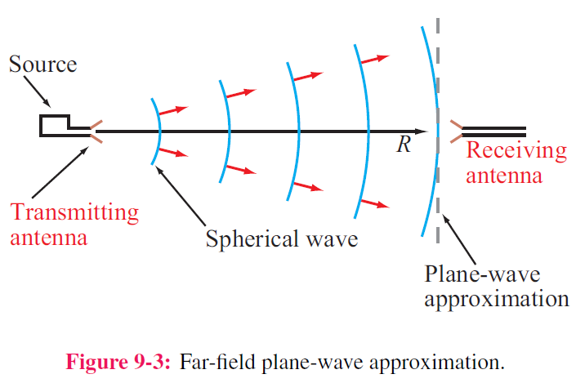
Far-Field Approximation
1. In close proximity to a radiating source, the wave is spherical in shape, but at a far distance, it becomes approximately a plane wave as seen by a receiving antenna.
2. The far-field approximation simplifies the math.
3. The distance beyond which the far-field approximation is valid is called the far-field range (will be defined later).
Most antenna characteristics are defined and discussed in the Far-Zone only.

Slide 19
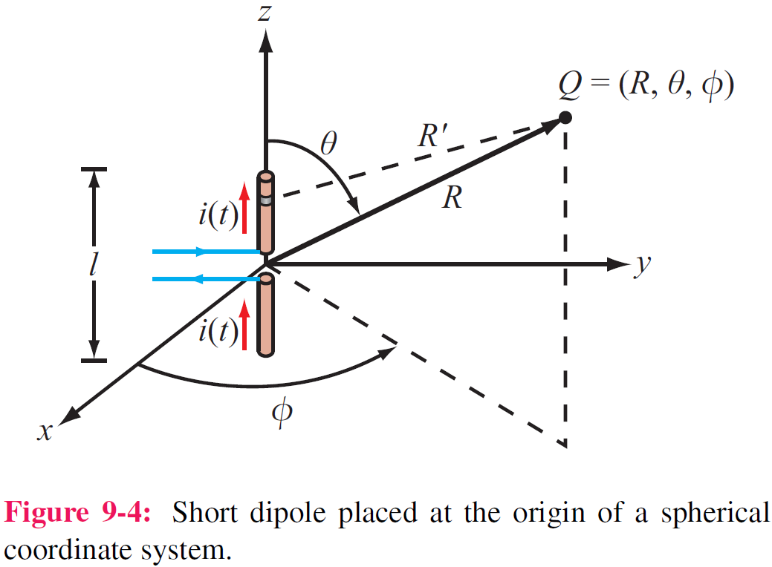
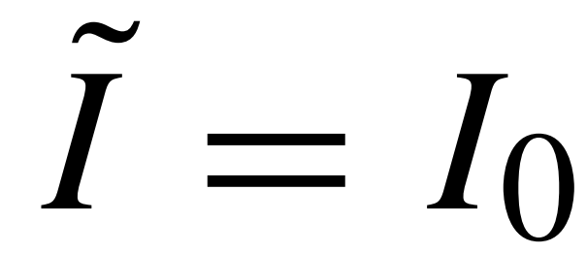
The Hertzian Dipole
Definition: A Hertzian dipole is a thin, linear conductor whose length l is very short compared with the wavelength λ. l < λ/50.
Current distribution: this restriction allows us to treat the current along the length of the conductor as constant, even though it has to decay to zero at the ends of the wire.
Amplitude of current
I₀
z
The field of the entire antenna may be obtained by integrating
the fields from all these differential antennas, with the proper
magnitudes and phases taken into account

Slide 20
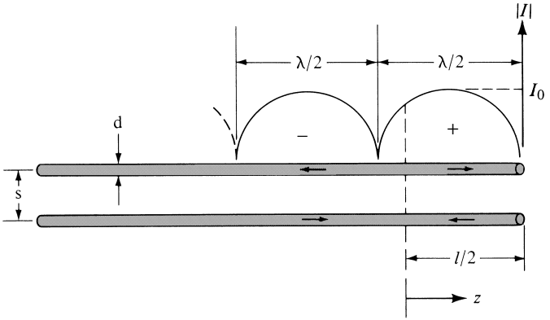
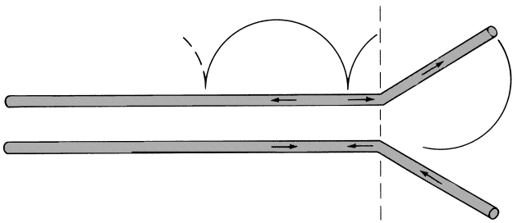
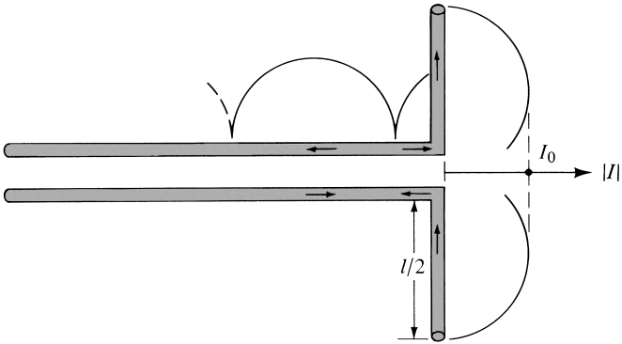
Current Distribution on Wires
The wave traveling between the wires undergoes a total reflection at the end of the wire and forms standing wave on the wires
The current at the end of the wires are always zero

Slide 21
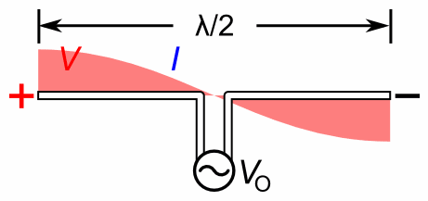
Current and Voltage Distribution
Half wave
When antenna length is very, very, very small, the current distribution goes to uniform. (Hertzian dipole)
Amplitude of current
I₀
Field radiated ？
z

Slide 22
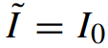
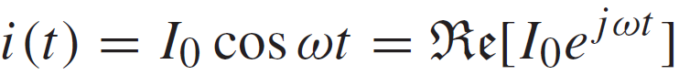
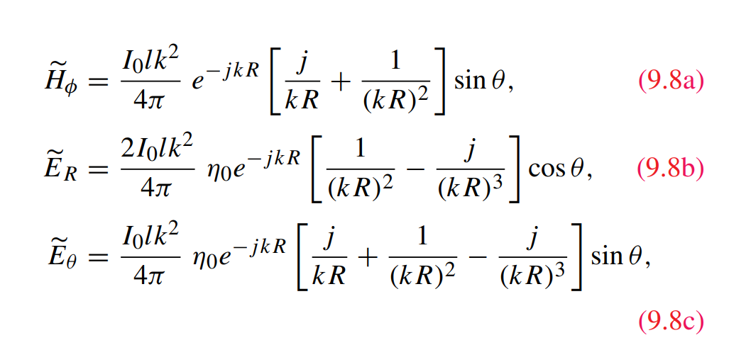
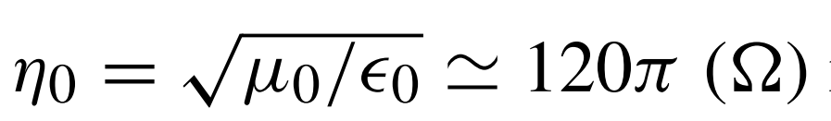
Fields Radiated by Hertzian Dipole
1. Current distribution along a Heartizian dipole:
Phasor form
(constant)
Time varying
2. E-field and H-field produced
is the intrinsic impedance of free space.

Slide 23
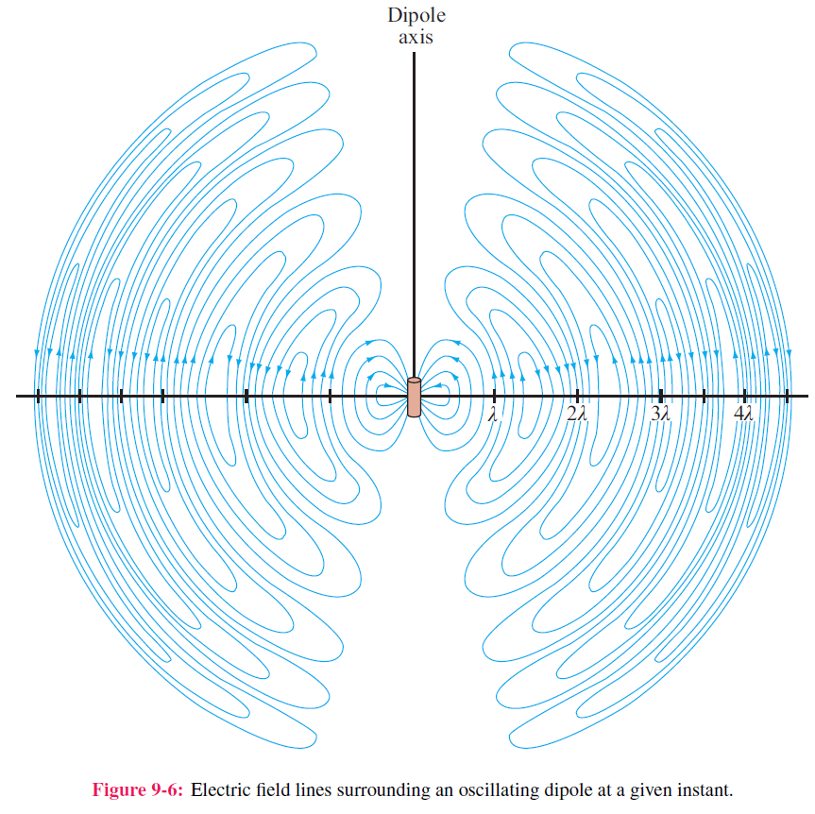
Radiated Electric Field
What we are interested ？
Fields at a distance of R far from the source
Completed form

Slide 24
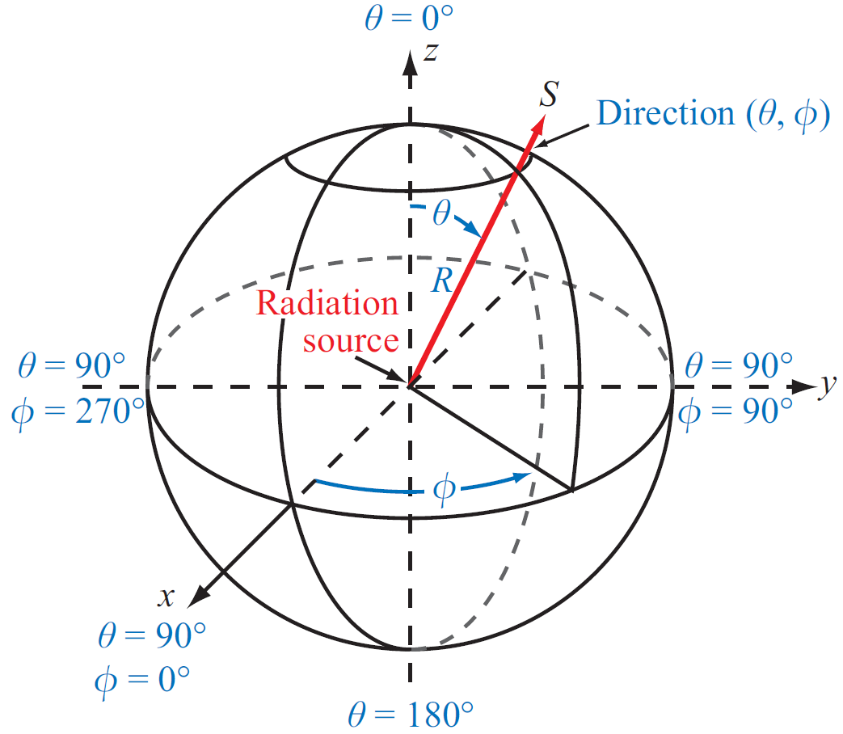
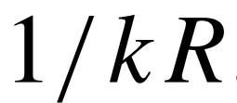
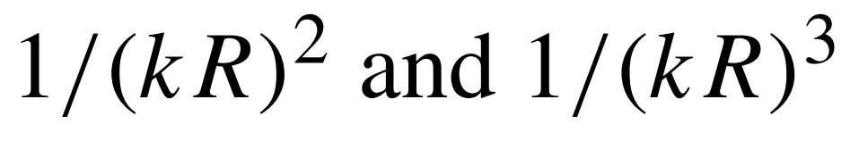
Fields Radiated by Hertzian Dipole (cont.)
Completed form
Far-field approximation
When kR >> 1, dominates the radiation
are neglected
though, they dominate the near-field

Slide 25
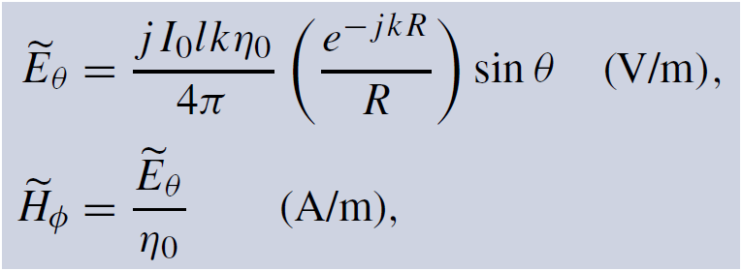
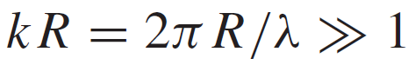
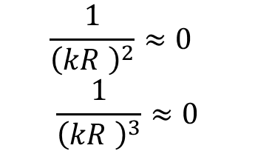
Hertzian Dipole—Far-Field Approximation
Far-field of Hertzian dipole
At
$$\frac{1}{{\left(kR \right)}^{2}}≈0$$
$$\frac{1}{{\left(kR \right)}^{3}}≈0$$

Slide 26
Hertzian Dipole—Far-Field Approximation
Far-field of Hertzian dipole
Polarization of Hertzian dipole
Antenna Polarization: polarization of the EM wave radiated by the antenna in a given direction
Importance:
If there is no reflection from environment (multi-path propagation), the TX antenna and RX antenna must be in the same polarization for maximum transmission, which will be seen later in the Friss Equation.
If there are multiple reflections, an optimum polarization may be found by channel estimation.

Slide 27
Antenna Radiation Characteristics
Radiation Intensity
Radiation Pattern
Half-Power Beamwidth
Antenna Directivity
Radiation Efficiency
Antenna Efficiency
Antenna Gain
Bandwidth

Slide 28
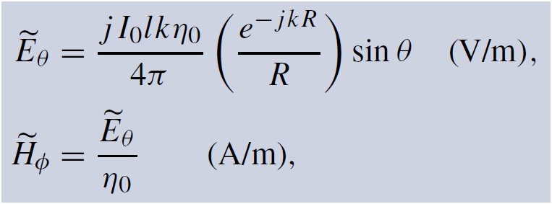
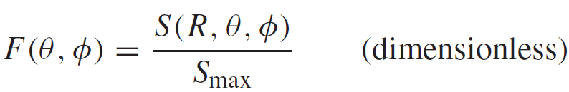
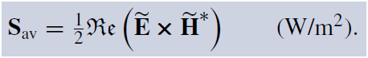
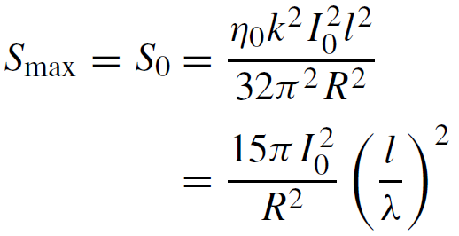
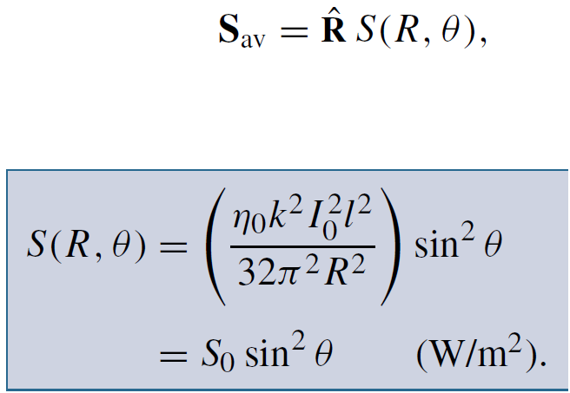
Normalized Radiation Intensity
Where the radiated energy goes ？
Electric and Magnetic Fields
Normalized Radiation Intensity
When θ=90°
Average Power Density (W/m²)
W/m²
Proportional to |I₀|² and (l/ λ)²

Slide 29
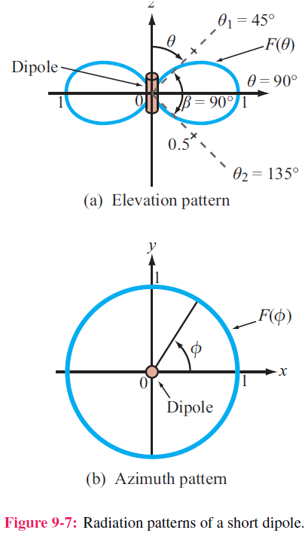
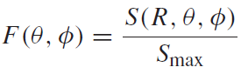
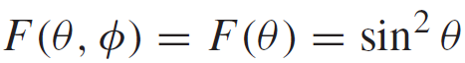
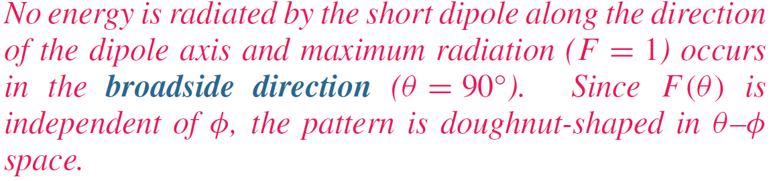
Radiation Pattern of Hertzian Dipole
Careful, ratio of power, not field
Normalized Radiation Pattern

Slide 30
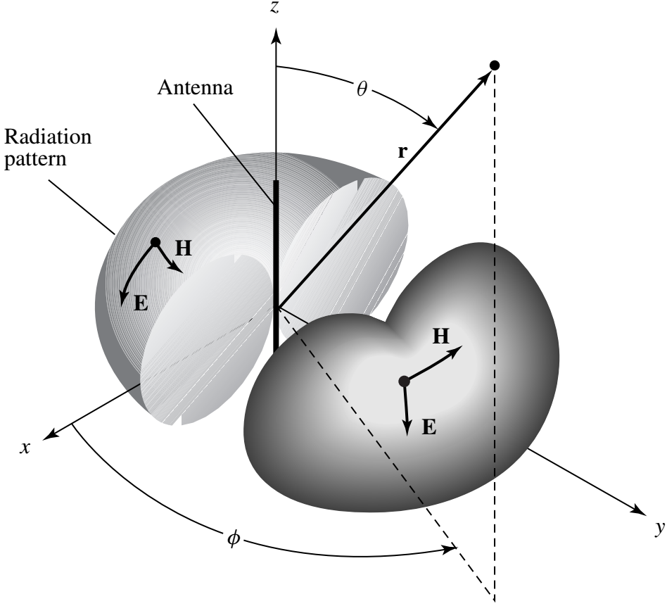
3D Radiation Pattern of A Dipole
Radiation Pattern:
Far-field properties
A function of direction (θ，φ)
A dimensionless quantity
Describes the ability of antenna to collect power from or radiate power toward a specified direction.
By virtue of reciprocity, a receiving antenna has the same directional antenna pattern as the pattern that it exhibits when operated in the transmission mode.

Slide 31
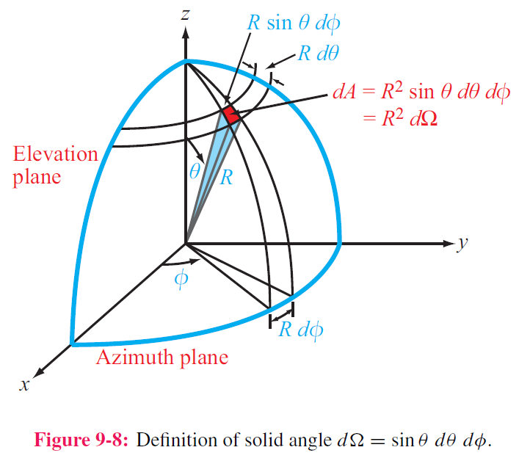
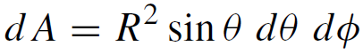
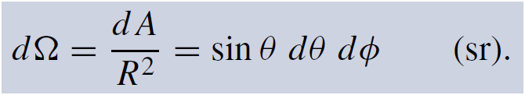
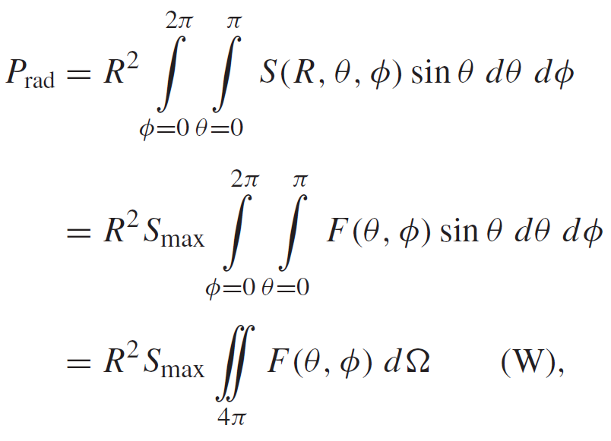
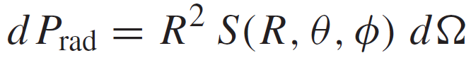
Total Radiation Power (P_{rad})
A surface integral by math
2. Total Radiated Power
Differential area
Solid Angle
Total Radiated Power
Power radiated through dA

Slide 32

Example of 3-D Pattern
Not 20 as it is defined by ratio of power, rather than field intensity
F (dB) = 10 log F
Principal planes:
1. Elevation plane (x-z and y-z planes)
2. Azimuth plane (x-y plane)

Slide 33



Different Pattern in Different Scale
Not a dipole, but another antenna

Slide 34

Polar and Rectangular Plots

Slide 35


Beamwidth
Half-power beamwidth (HPBW)
IMPORTANT
Since 0.5 corresponds to ‒3 dB, the half power beamwidth is also called the 3-dB beamwidth.

Slide 36


Pattern Solid Angle
steradian
Equivalent Solid Angle
See p. 412

Slide 37






Antenna Directivity D
Antenna pattern solid angle
Maximum normalized radiation intensity = 1
Directivity
Average value of F(θ,φ) over all directions
$$\iint_{4π}{F\left(θ,φ\right)dΩ}=\frac{P_{rad}}{R^{2}S_{max}}$$
$$D≥1$$
$$D=\frac{4πR^{2}S_{max}}{P_{rad}}=\frac{S_{max}}{S_{av}}$$

Slide 38



Cont.

Slide 39


(cont.)

Slide 40

IMPORTANT

Slide 41


Radiation Efficiency and Gain
Radiation efficiency
Radiation efficiency does not consider impedance mismatch
Antenna gain G
IMPORTANT

Slide 42




Antenna Radiation and Loss Resistances
Antenna is merely a load with input impedance Z_{in}
$$Z_{in}=R_{in}+jX_{in}$$
$$P_{t}=\frac{1}{2}I_{0}^{2}R_{in}$$
IMPORTANT

Slide 43

Cont.

Slide 44



Example 9-3 (cont.)
For any antenna:
For the Hertzian dipole:
IMPORTANT

Slide 45
Antenna Bandwidth
REQUIREMENT: given antenna characteristics to determine required bandwidth
Definition
The frequency range within which all requirements of antenna characteristics are satisfied simultaneously.
Example
A base-station antenna for mobile communication has the following technical specifications.
Bandwidth: 3.4 – 3.8 GHz
Specification | Test Results | Bandwidth
VSWR | <1.5 | 3.2 – 3.8 GHz
Antenna Efficiency | > 75% | 3.4 – 4.5 GHz
HPBW | 120°±5° | 3.4 – 4.2 GHz
Gain flatness | < 1dB | 3.3 – 4.6 GHz
Cross-polarization level | < -20 dB | 1.5 – 12 GHz
Gain Flatness < 1dB
Ant. Eff. > 75%
HPBW
VSWR<1.5
X-pol
DC
Freq. (GHz)

Slide 46
Image Theory
IMPORTANT
Motivation
The radiation of antennas are determined by source and boundaries. Therefore, it matters where an antenna is mounted on or what exists nearby.
Definition
The effect of a boundary on antenna far field can be replaced by a virtual source
Example
A segment of conducting copper wire that carries oscillating currents
Case I: the current is vertically placed above an infinitely large PEC plate.
Electric currents
Simplified model Arrow shows direction of current flow
Conducting wire
Electric
currents
Feeding gap
(voltage source)
PEC plate
To be continued.

Slide 47

Image Theory (monopole)
Motivation
The far-field radiation characteristics of antennas are determined by source and boundaries. Therefore, it matters where an antenna is mounted on or what exists nearby.
Example
A segment of current vertically placed above an infinitely large PEC plate.
A segment of conducting copper wire that carries oscillating currents
From original problem to equivalent problem
Original
Equivalent for upper space ONLY
-
–
+
+
An image current of same orientation is placed below the ground, as if the total field IN THE ORIGINAL SPACE was produced by both currents without the ground. However, ZERO is the field in the lower half space. (effect of ground is replaced by image source). Textbook pp. 420 and Figure 9-15.
–
Zero field for lower-half space
+

Slide 48
Image Theory (monopole)
Important characteristics of λ/4 monopole
Pattern of a λ/4 monopole looks like a λ/2 dipole for half space
The radiation is limited to upper half-space (0 ≤ θ ≤ π/2)
A monopole radiates only half as much power as the dipole
P_{rad} = 18.3 I₀² and R_{rad} = 36.5 Ω
A segment of conducting copper wire that carries oscillating currents
Questions
What may be a good length of the monopole of your antenna project?
What may be the width of the ground plane when infinite ground is impossible?(Effect of finite ground.)
Is it OK to have a length of Nλ/4 for the antenna project? For example, VSWR, antenna efficiency, input impedance, antenna matching and so on… (different resonant mode with different radiation pattern)
HINT:
simulation can answer the above questions

Slide 49
Image Theory (general summary)
REQUIREMENT: sketch the image of a given source and boundary.
Image of electric and magnetic currents over infinite PEC plate
Electric currents
Magnetic currents
PEC
Image of electric and magnetic currents over infinite PMC plate
Electric currents
Magnetic currents
PMC

Slide 50





Half-Wave Dipole
Now we calculate the field of λ/4 monopole by looking at λ/2 dipole
1. Current in half-wave dipole （phasor）
2. For Hertzian dipole of length l, E field is:
3. Each length element dz of half-wave dipole is like a Hertzian dipole, radiating a field
4. For the entire dipole, the total radiated field is
Derivation not required
Field summation theorem
See p. 418

Slide 51



Half-Wave Dipole (cont.)
Integration leads to:

Slide 52


Radiation Pattern of Half-Wave Dipole
Radiation pattern resembles that of the Hertzian dipole. Its beamwidth is slightly narrower, 78 degrees compared with 90 degrees for the Hertzian dipole.
REQUIREMENT: given a radiation pattern in terms of mathematical function, to sketch the shape of the radiation pattern in a given plane.

Slide 53




Other Half-Wave Dipole Properties
1. Directivity
2. Radiation Resistance
Numerical integration gives:
This is very important, because it makes it easy to match the antenna to a 75-Ω transmission line. In contrast, the radiation resistance of a dipole whose length is much shorter than a wavelength is on the order of 1 Ω or less.

Slide 54





Dipole of Arbitrary Length
Length of dipole controls the radiation pattern by controlling the current distribution over the wire. (because field is a result of source and boundary)
OPTIONAL

Slide 55


Radiation Pattern of Different Dipole
The pattern helps answer an earlier question about the length of the monopole, do you remember?
OPTIONAL

Slide 56



Friis Transmission Formula
IMPORTANT
Motivation
How much power is received by a receiving antenna?
How to improve the receiving power?
RX gain
Spherical factor
[4π(R/λ)]⁻²
TX pattern
TX gain
RX pattern
pp. 427–428
P_{rec} is direction dependent

Slide 57
Two-Element Antenna Array
Major Motivation
To increase antenna gain and directivity.
To shape the radiation pattern so energy & signal can be delivered to required direction.
To generate multiple beams.
To filter out undesired noise from certain directions
To combine EM power in space (rather than in circuit for guided waves)
To control reflected wave （reflectarray）
Definition:
An array of antenna elements (identical or different) fed by a combination of weighted signals, from guided-wave network or space, for a desired summation of total field. For example, beam steering, energy focus, holography, beam switching etc.

Slide 58
Two-Element Antenna Array
An antenna array to a continuous aperture is analogous to digital data to analog. By controlling the signals fed into individual array elements, the pattern can be shaped to suit the desired application.
Also, through the use of electronically controlled solid-state
phase shifters, the beam direction of the antenna array can
be steered electronically by controlling the relative phases
of the array elements.
This flexibility of the array antenna has led to numerous
applications, including electronic steering and multiple-beam
generation.

Slide 59






Two-Element Antenna Array
z
Example
Given the far-field of a z-oriented Hertzian dipole
y
x
An additional Hertzian dipole of identical current magnitude is further added at the origin but oriented along x-axis.
Determine the total field at a distance of R, in the direction of θ = φ = π/2,. State the polarization of the total field in the direction
Key is field summation theorem
$$E_{1}=E_{θ}^{z}=\hat{θ}\frac{jI_{0}lkη_{0}}{4π}\left(\frac{e^{−jkR}}{R}\right)\sin{θ}，$$
$$E_{1}=−\hat{z} \frac{jI_{0}lkη_{0}}{4π}\left(\frac{e^{−jkR}}{R}\right)$$
$$when θ=φ=\frac{π}{2}$$
$$E_{2}=E_{θ}^{x}=\hat{φ}\frac{jI_{0}lkη_{0}}{4π}\left(\frac{e^{−jkR}}{R}\right)\sin{φ}，$$
$$E_{2}=−\hat{x} \frac{jI_{0}lkη_{0}}{4π}\left(\frac{e^{−jkR}}{R}\right)$$
$$Therefore, E_{total}=E_{1}+E_{2}=\left(−\hat{z}−\hat{x}\right)\frac{jI_{0}lkη_{0}}{4π}\left(\frac{e^{−jkR}}{R}\right), Linear Polarization$$

Slide 60
Summary
Introduction of Antenna Project
Due in 17 days : Simulation, fabrication, testing and writing.
Radiation Mechanism
Deep understanding of radiation mechanism: acceleration
Basic Principles
Field summation theorem
Image theory: point charge, electric/magnetic currents, PEC/PMC
Far-field approximation
Hertzian Dipole
Current, field, pattern and polarization
Coordinate System

Slide 61
Summary
Basic Antenna Radiation Characteristics
Radiation intensity and radiation pattern
Concepts of Reciprocity, Polarization, pattern, two efficiencies, directivity, gain, HPBW, bandwidth
Circuit model and antenna impedance: physical meaning of Rrad, Rloss, reactance and controlling factors.
Half-wave Dipole
Current, field, pattern and polarization
Friis Transmission Formula
Clear understanding of each parameter for calculation of power delievery
Two-Element Array
Field summation theorem is the key

